Slide 1
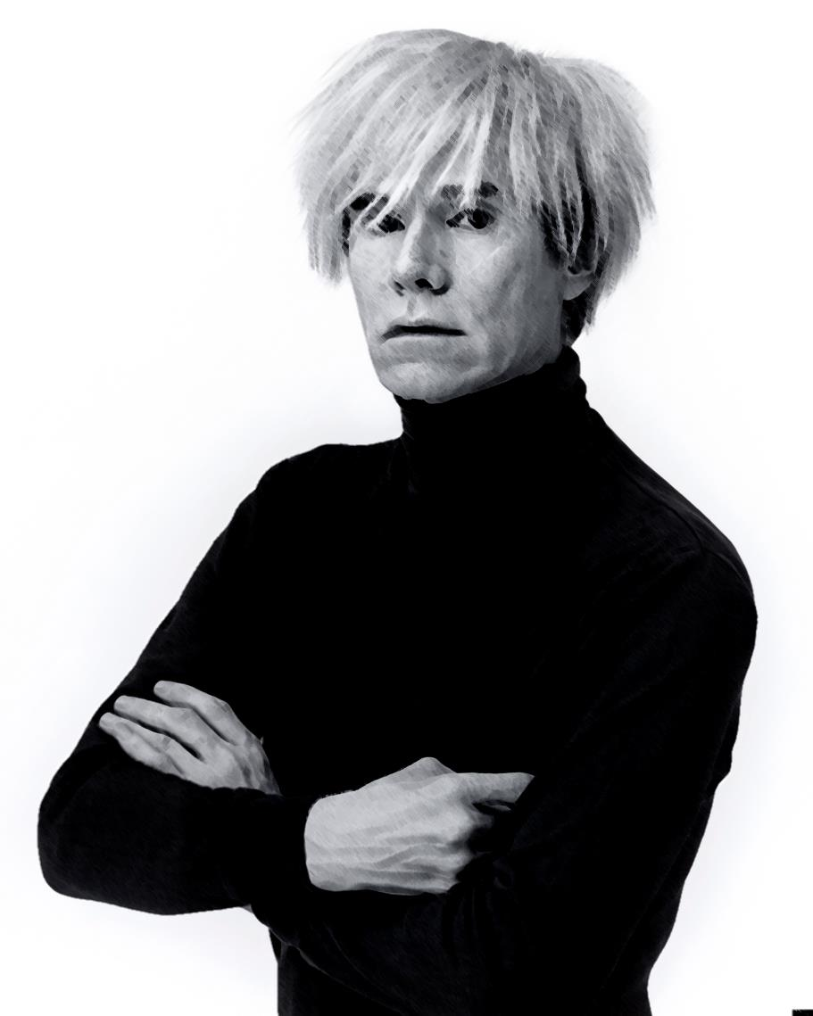
Andy Warhol
(1928-1987)
02/12/15

Slide 2
Andy Warhol
Born on August 6, 1928, in Pittsburgh, Pennsylvania. He was a successful magazine and ad illustrator. Also the leading figure of the pop art movement or visual art movement. Now, The Andy Warhol Museum that is in Pittsburg, Pennsylvania, holds permanent collections of art of him. It is the largest museum in the Unite States that is dedicated to a single artist. Warhol's art used many types of media, including hand drawing, painting, printmaking, photography, silk screening, sculpture, film, and music. He is also notable as a gay man who lived openly before the gay liberation movement.

Slide 3
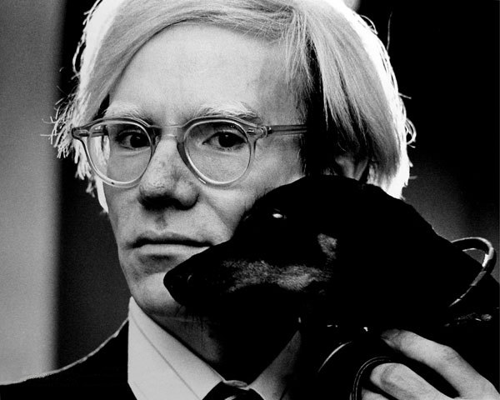
Early Life
Andy Warhol's parents were Slovakian. His father, Ondrej Warhol, was a construction work. His mother, Julia Warhol, was an embroiderer. Warhol had Sydenham's chorea also known as St. Vitus' Dance, a disease in the nervous system that causes involuntary movements of the extremities, which is believed to be a complication of scarlet fever which causes skin pigmentation blotchiness.

Slide 4
Miller Shoe Ad

Slide 5
Self-Portrait, 1986.

Slide 6
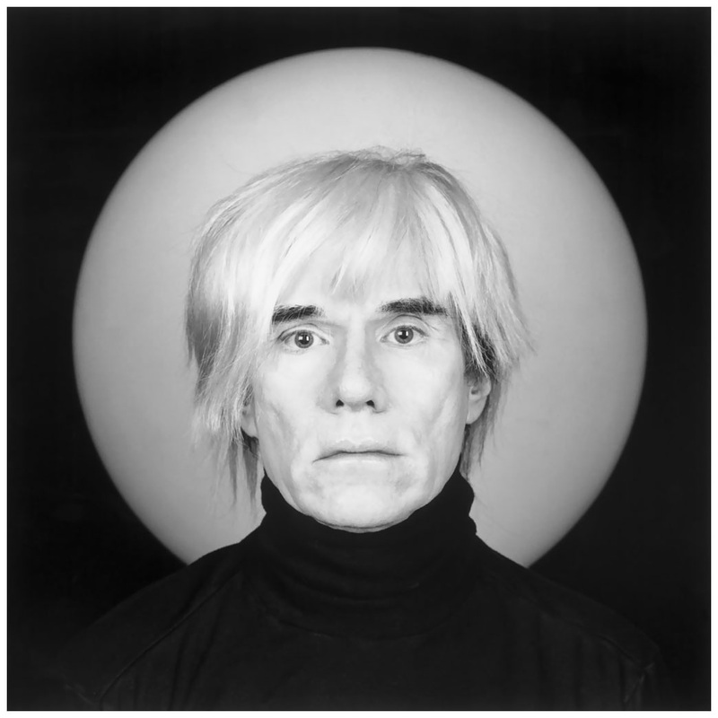
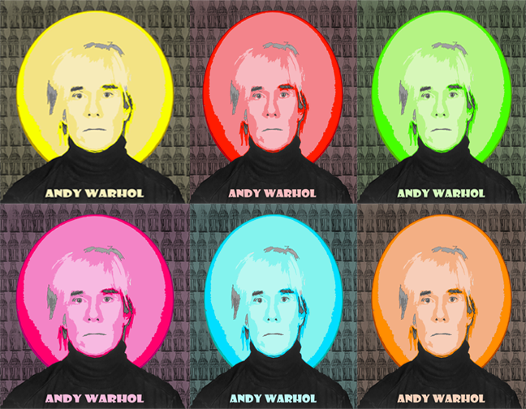
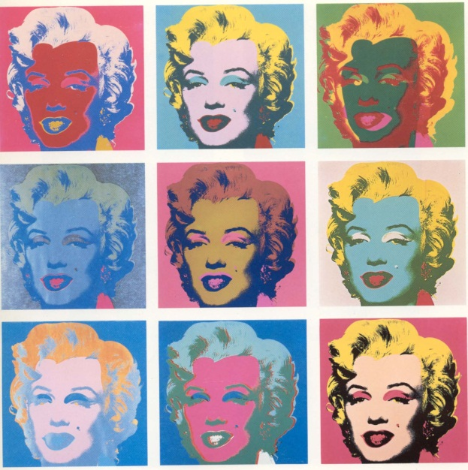
Homage

Slide 7
Reflection
I enjoyed doing this presentation of Andy Warhol and I learned a lot about him. His work is very eye catching and I think he is a very good artist. I picked Andy Warhol because I love his style of art and editing like it. Even with so many barriers, he has succeeded in being successful and doing the things he like. This was a good experience doing a presentation on Andy Warhol.

Slide 8
THE END
Website: www.warhol.org

