Slide 1
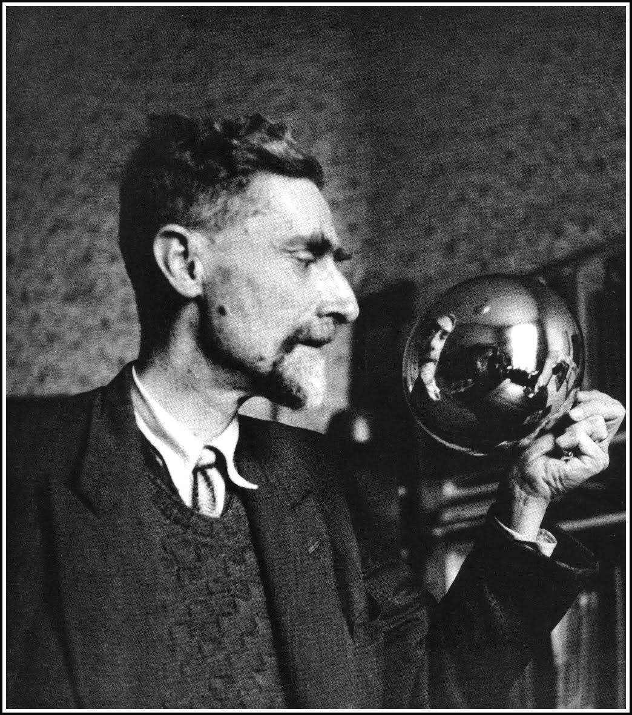
Maurits Cornelis Escher
(1898-1972)
05/04/15

Slide 2
Escher’s Life
Escher was born in Leeuwarden, Netherlands. The fourth and youngest son of a civil engineer. He spent most of his time in Arnhem.
Since he failed most of high school, he was enrolled to the School for Architecture and Decorative Arts in Haarlem, and after confronting his father he did Graphic arts.
His graphic art teacher was Samuel Jessurun de Mesquita, who had a hope in him.
After school he travelled around Italy where is met Jetta Umike, his wife.
They stayed in Rome from 1924-1935; during these eleven years, he travelled yearly everywhere Italy with the objective of making art.

Slide 3
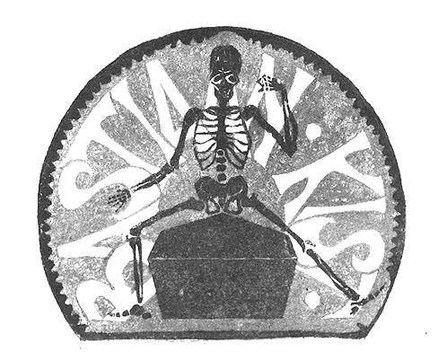
Early Artwork
Bookplate Bastiaan Kist
(1916 Linoleum cut in red and black.)
Escher’s Father
(1916 Linoleum cut in purple)

Slide 4
M. C. Escher
Escher is the world’s most famous graphic artists.
Escher is most recognized for Impossible Constructions and Transformation Prints.
When he lived and travelled in Italy, he made realistic art too. Like the Castrovalva and Atrani.
During his lifetime, he made 448 lithographs, woodcuts and wood engravings, and over 2000 drawings and sketches.

Slide 5
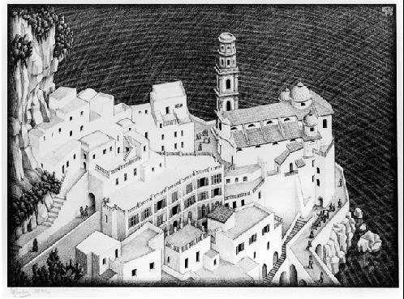
Realistic Art in Italy
Atrani, Coast of Amalfi
(1931 Lithograph)
Castrovalva
(1930 Lithograph)

Slide 6
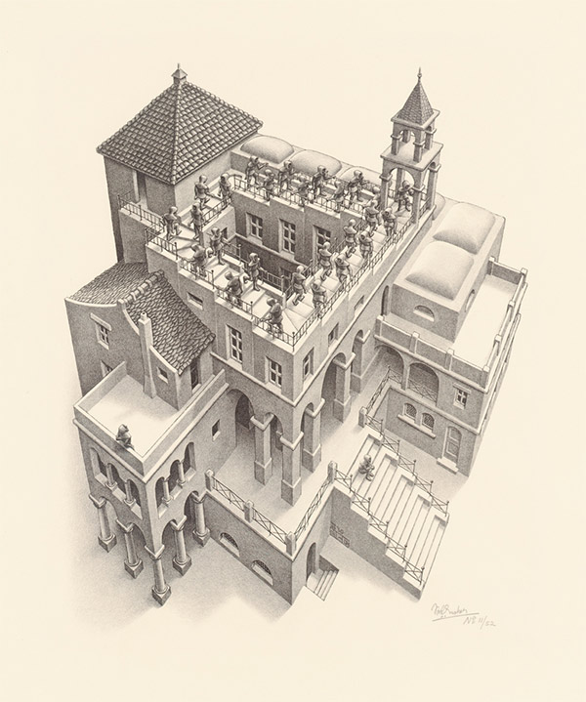
Impossible Constructions
Relativity (1953 Lithograph)
Ascending and Descending
(1960 Lithograph)

Slide 7
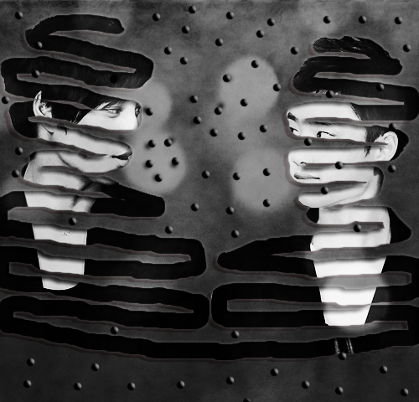
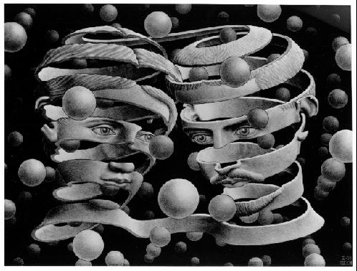
Homage (Bond of Union)
Bond of Union (1956 Lithograph)
Homage

Slide 8
Reflection
I chose M.C. Escher for this artist presentation because I love architecture and graphic designing, which were some of my career choices to do in the future. I loved doing this presentation because I got the chance to see different ways of how Escher used his imagination in geometric ways and made masterpieces throughout his life. I like geometric figures that are smooth and neat, so I liked his style of art. I believe that I deserve an A in this artwork because I’ve learned from my last flaws and I have met my requirements.

