Slide 1
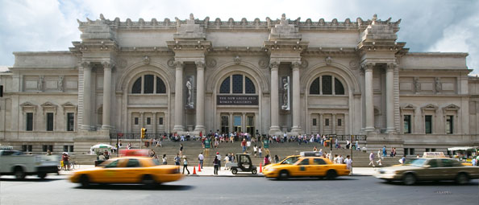
Metropolitan Museum of Art (new york City, New york, USA)
By Sithumini Navaratne

Slide 2
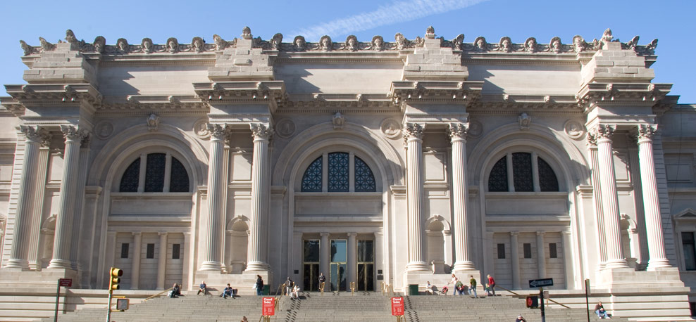
The Metropolitan Museum of Art is located in New York city. It is the largest art museum in the United States and is in the list of ten largest museums in the world.

Slide 3
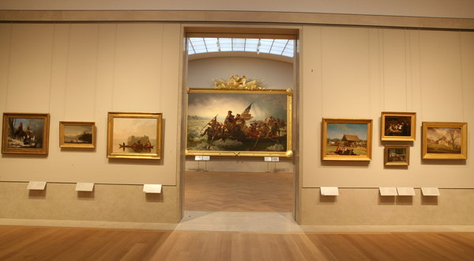
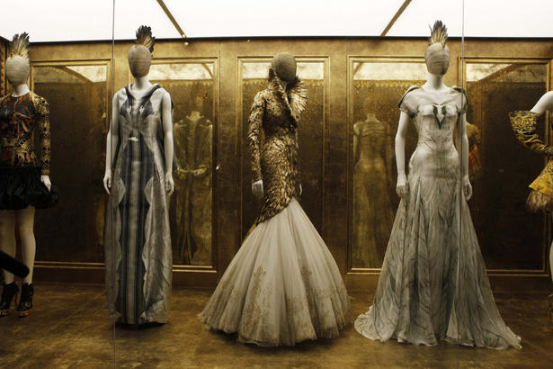
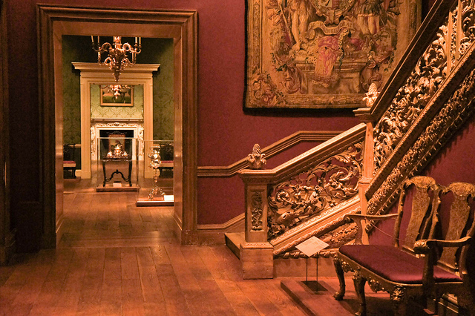
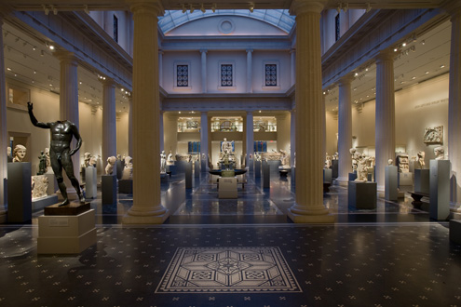
Its permanent collection contains more than two million works, divided among seventeen departments.

Slide 4
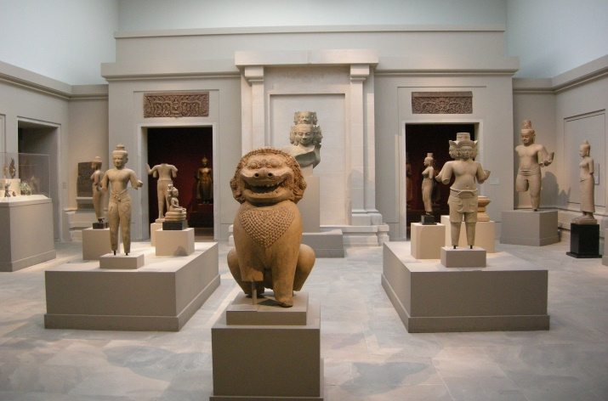
The collection are works of art from classical and ancient Egypt, paintings and sculptures from nearly all the European masters, and an extensive collection of American and modern art. Holds African, Asian, oceanic, and Islamic art.

Slide 5
It Has collections of musical instruments, costumes and accessories, and antique weapon and armor from around the world.

Slide 6
Reflection
I enjoyed doing this museum as a presentation, because the Metropolitan Museum of Art has many art and monuments that I look forward to seeing. This museum has different departments that I’m interested in, such as the Photography, Musical Instruments, Modern Art, Drawing and Prints, Costume Institute, Arms and Armor departments and at last the Cultural Art departments. I really look forward to go to this museum one day. My favorite part of the museum is the musical instruments collection.

Slide 7
The End
Website:
http://www.metmuseum.org/

