Slide 1
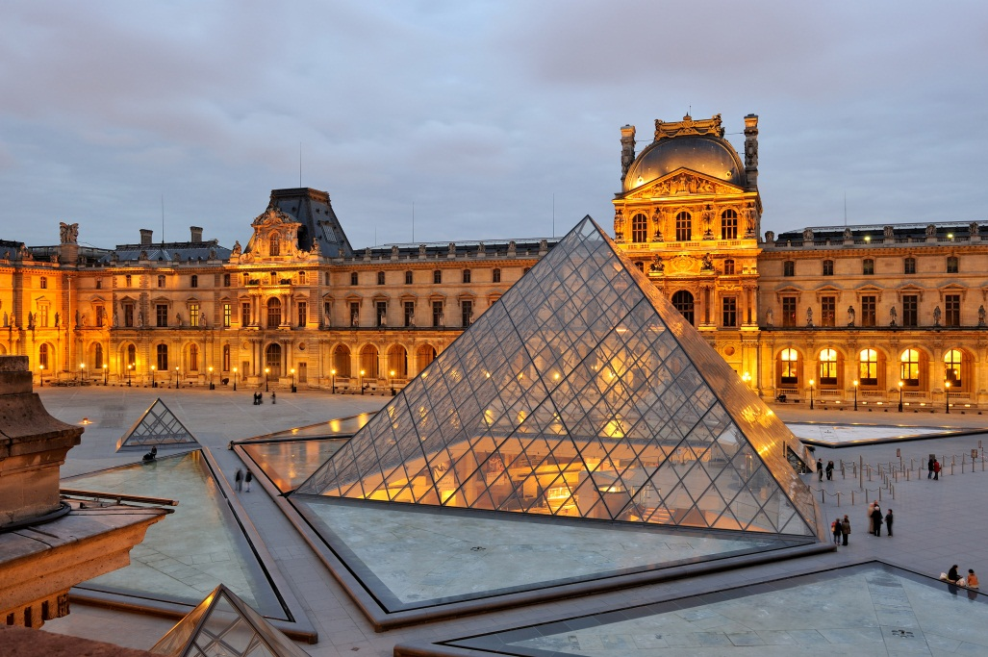
Musée du Louvre, 75058 Paris – France
January 13th, 2015
Computer Art
Sithumini Navaratne

Slide 2
Louvre
The Louvre is one of the world's largest museums that is a central landmark of Paris, France and a historic monument.
It is the most visited museum with a population of almost 10 million visitors every year.
The museum is in the Louvre Palace, which was originally built as a fortress under Philip II in the late 12th century.
The museum opened on 10 August 1793 with an exhibition of 537 paintings.
The oldest work stationed in the museum is a 9,000-year-old plaster statue of a human figure found in Jordan.

Slide 3
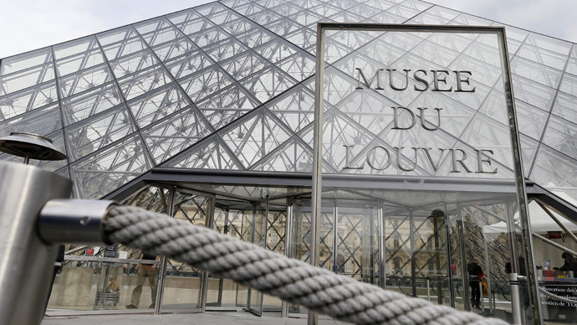
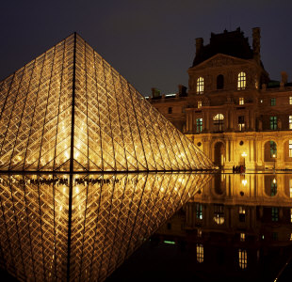
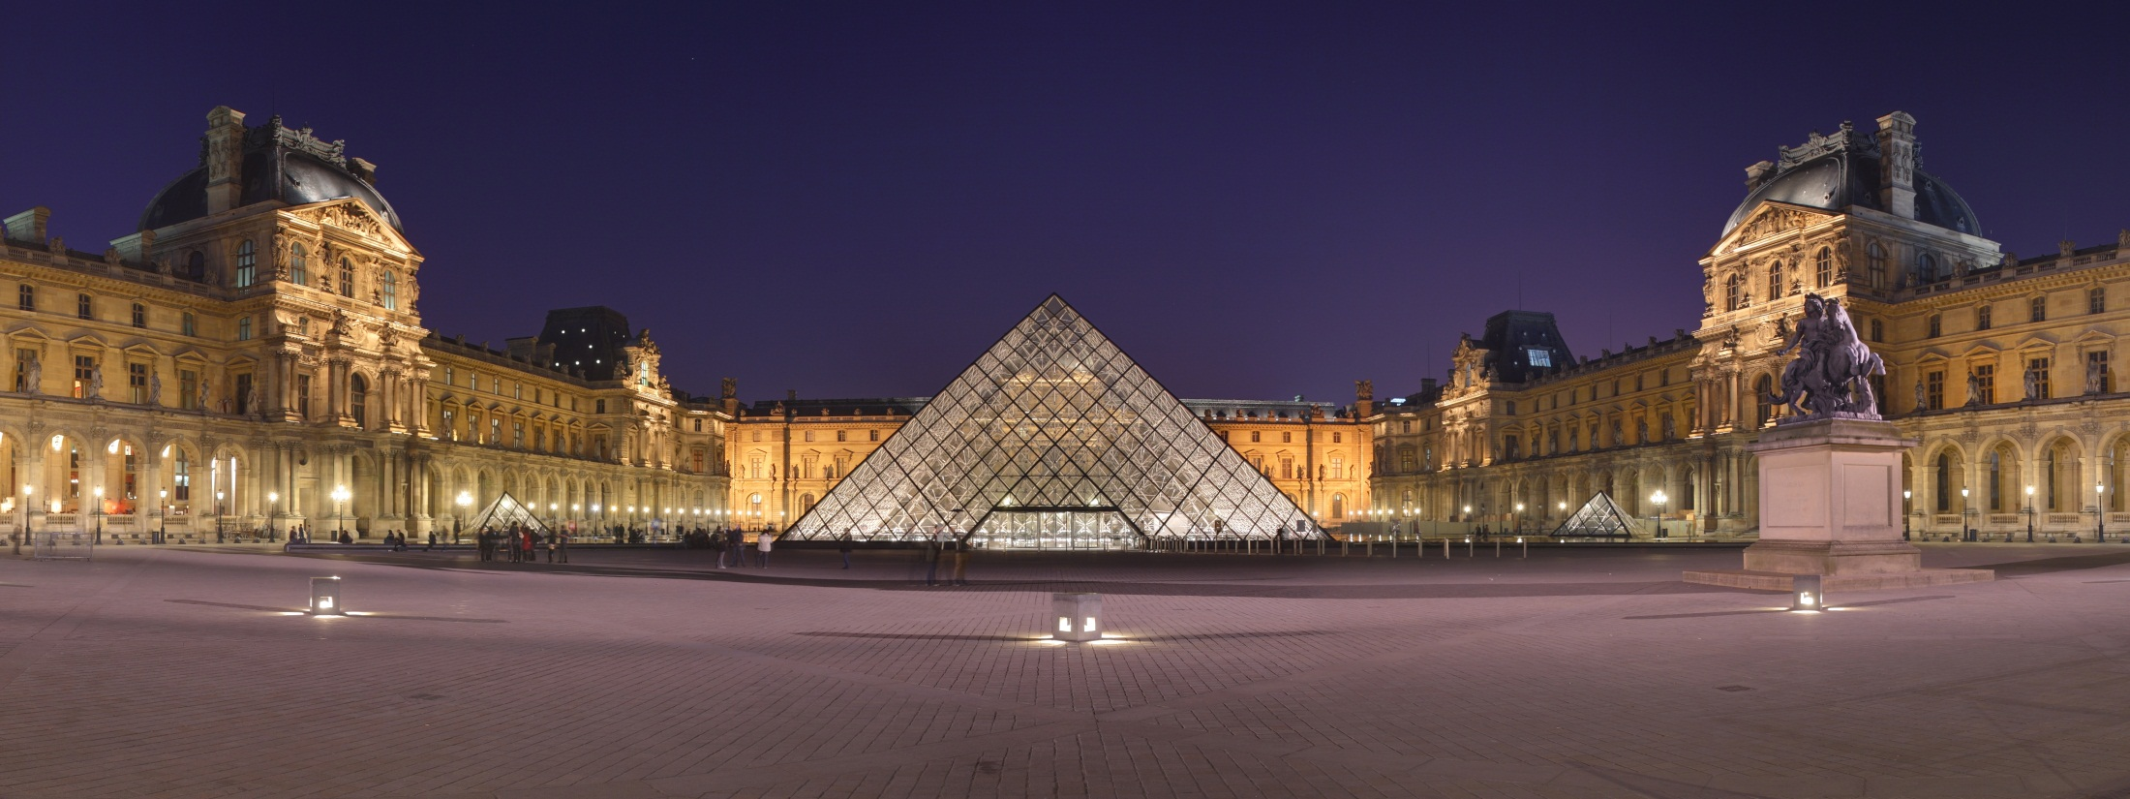
Louvre Exterior

Slide 4
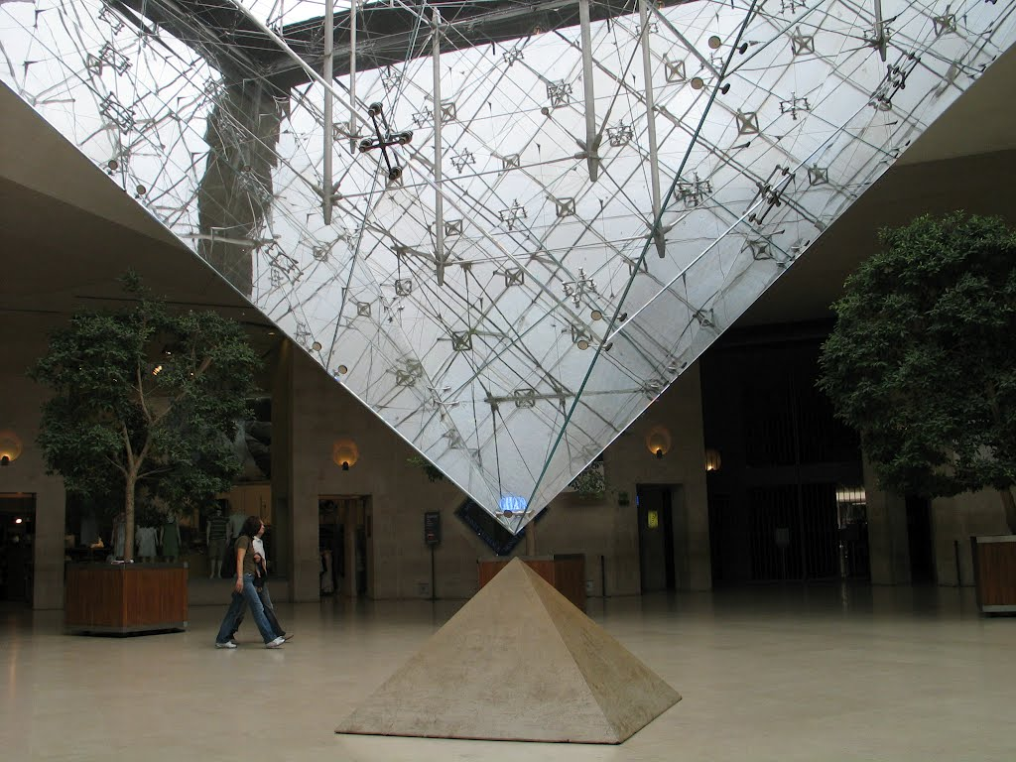
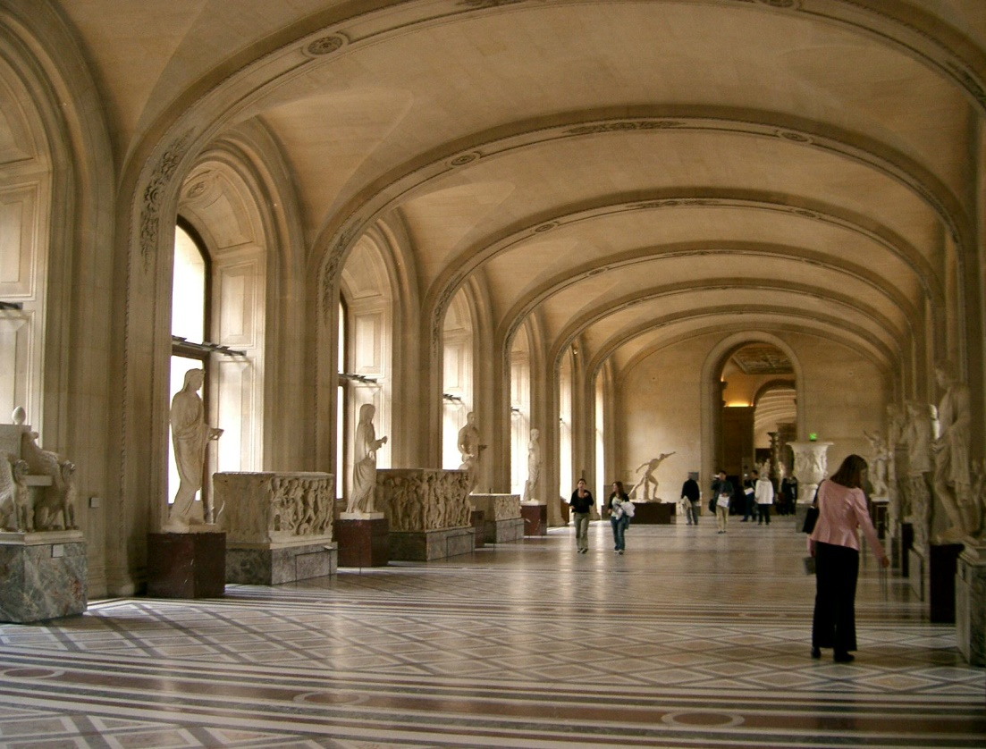
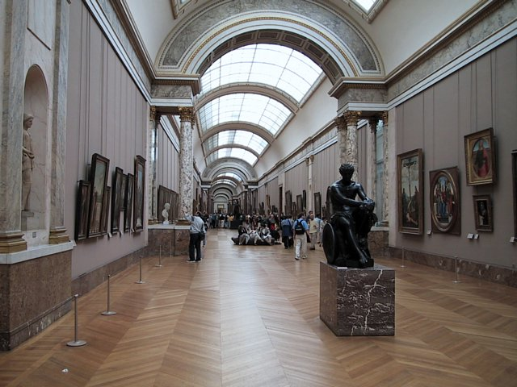
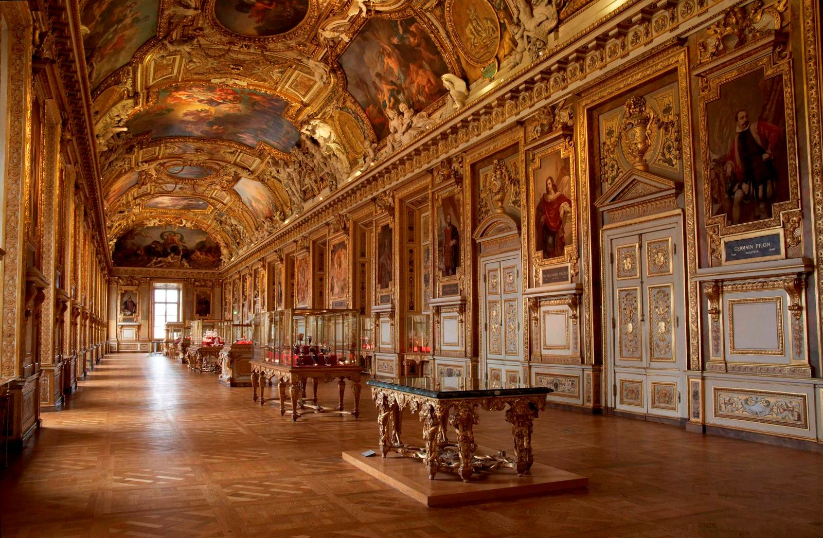
Louvre Interior

Slide 5
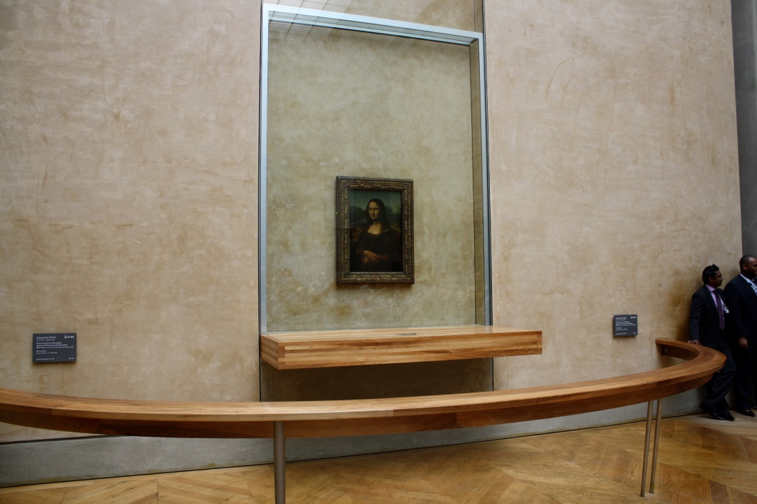
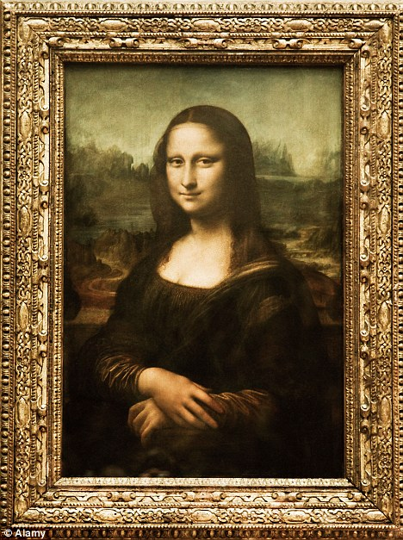
Paintings:The Louvre Museum displays the famous Mona Lisa by Leonardo da Vinci.
Mona Lisa is the portrait of Lisa Gherardini, wife of Francesco del Giocondo.
This portrait was painted in Florence between 1503 and 1506.

Slide 6
The Louvre Museum also displays superb collections of Egyptian, Greek and Roman arts and many other first class paintings from Italy, France, Flanders and the Netherlands.
The Musée du Louvre contains more than 380,000 objects and displays 35,000 works of art in eight curatorial departments with more than 60,600 square metres (652,000 sq ft) dedicated to the permanent collection.
Louvre opened a new Islamic department for Islamic art.
More facts about Louvre

Slide 7
Egyptian Antique
The Seated Scribe from Saqqara, Egypt, limestone and alabaster, circa 2600 and 2350 BC.

Slide 8
Sculpture
Tomb of Philippe Pot, governor of Burgundy under Louis XI, by Antoine Le Moiturier.

Slide 9
Reflection
I enjoyed doing this PowerPoint because Louvre is a museum that I always looked forward to go to. After making this PowerPoint I wanted to learn more about it and made it a life goal to visit it one day because of its vast collection of art history and architecture that I love a lot. Louvre’s architecture is the best part of it because it has a very beautiful and unique structure that catches the eye of many. It also has a lot of treasures from the history that shows art and structure that is irresistible. I believe that I deserve an A on this PowerPoint because my goals were met and the requirement were too. Additionally, I learned a lot about Louvre and this PowerPoint helped me gain knowledge about it and I hope I share some of this knowledge with you.

Slide 10
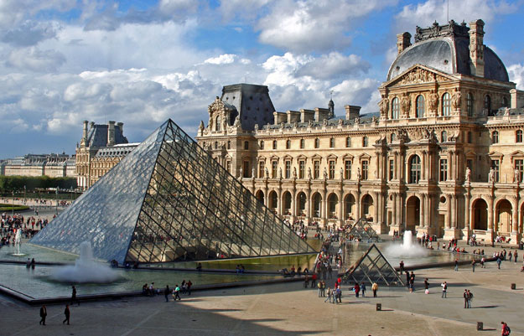
The End.
Louvre
Weibsite for Louvre: http://www.louvre.fr/

