Slide 1
Simone Legno
June 16, 1977
Done By: Sithumini Navaratne
November 27th 2014
Computer Art
Period 4

Slide 2
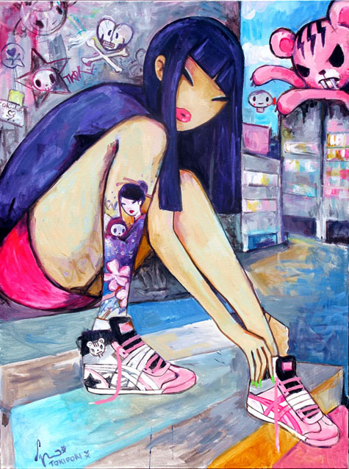
Simone Legno
Simone Legno was born, June 16, 1977 in Rome.
He is an Italian artist, who is the creative director and co-founder of the ‘tokidoki’ brand.
He is an artist that is interested in Japan and it’s culture which influences him to make his designs.
He studied at the European Institute of Design in Rome.
“Geisha”

Slide 3
Tokidoi
Pooneh Mohajer and Ivan Arnold are the couple who convinced Legno to come to Los Angeles and start a partnership with them.
Tokidoki means “sometimes” in Japanese and chose the word because he feels “everyone waits for moments that change one’s destiny, by chance or by meeting a new person”.
Tokidoki is in Los Angeles, CA, and was founded in 2003 by designer Simone Legno and his partners Pooneh Mohajer and Ivan Arnold.
“tokidoki” logo

Slide 4
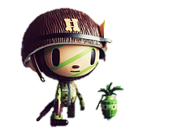
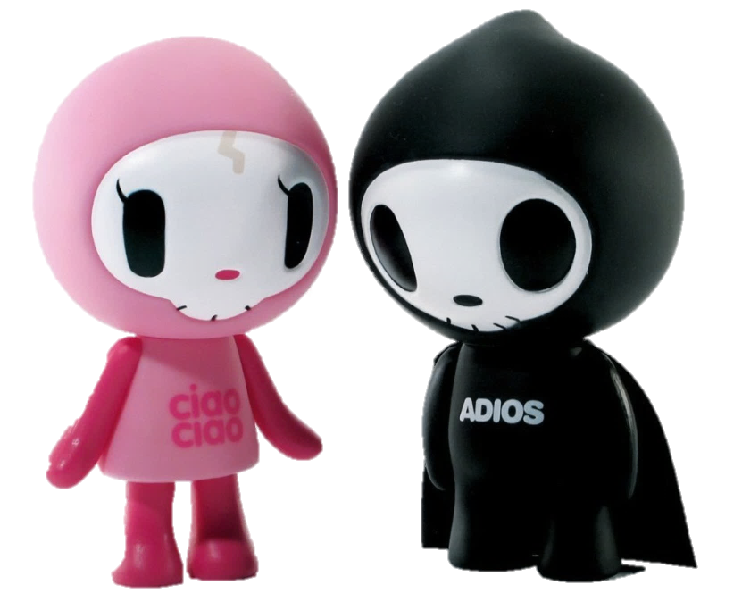
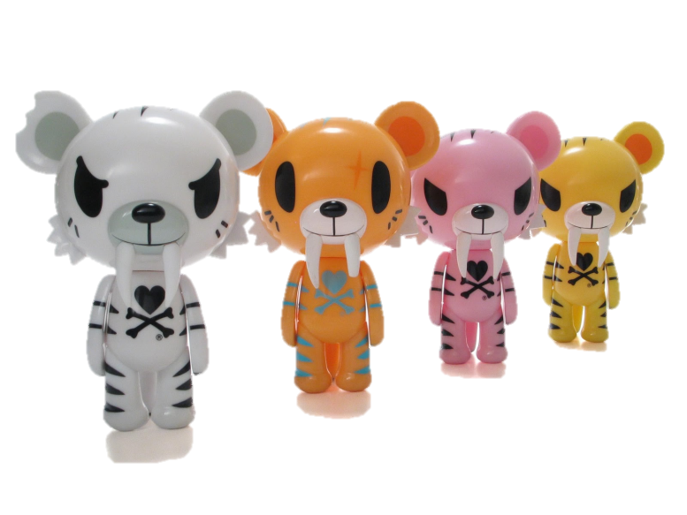
Legno’s Famous Works
Most popular work characters such as the "Moofia", "Cocomando", "Wild Boys", "'Til’ Death Do Us Part", and "Cactus Friends“.

Slide 5
Reflection
In my opinion Simone Legno is a very good example to
the younger artist as he worked on ‘tokidoki’ . Even before tokidoki was found by Pooneh Mohajer and Ivan Arnold, it got listed as one of the top ten websites of the week by The Independent in 2003 before he was found by . I enjoyed doing this artist because I, like the Japanese culture similarly to Simone Legno and I enjoy the cute characters of “tokidoki” such as Donutella and Unicorno. I think I deserve an A because I did all my research on Simone Legno and his brand ‘tokidoki’. I also got interested in his brand and I want to keep undated on it.

Slide 6
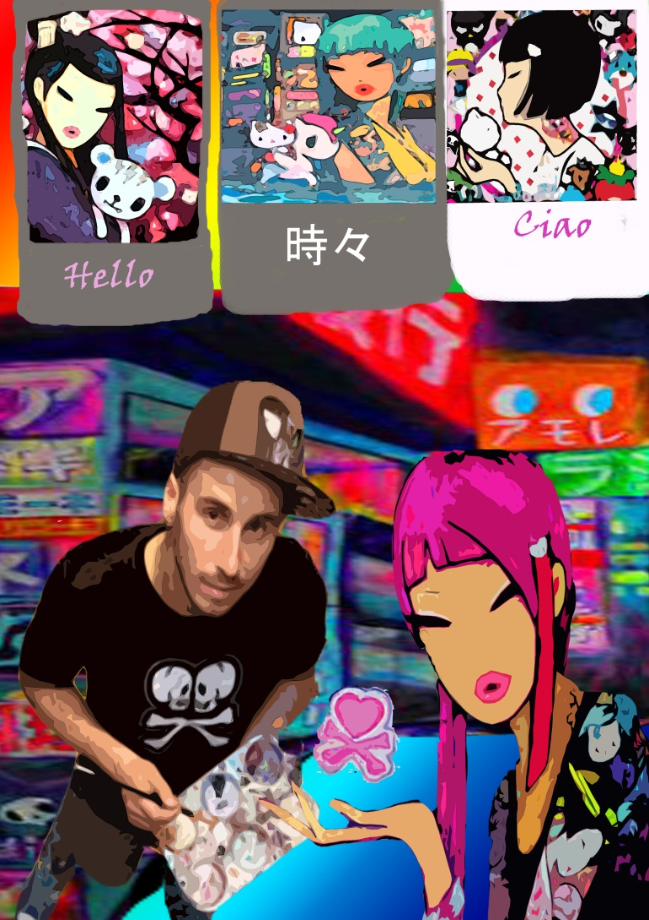
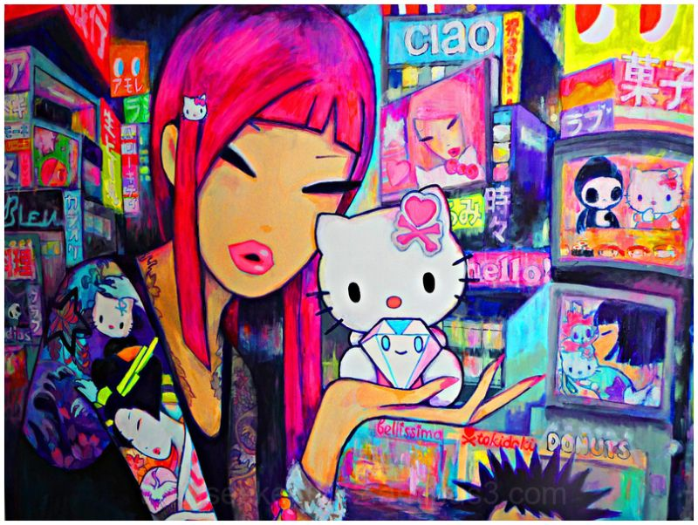
Homage

Slide 7
The End

